Slide 1
Introduction to Digital Technology
Professor Name
Professor of Digital Arts and Sciences
Professor of Music

Slide 2
Introduction to Digital Technology
Analog & Digital: What’s the Difference?

Slide 3

Part 2
Analog &
Digital
Devices

Slide 4

Part 2
Analog &
Digital
Devices

Slide 5
111
110
Level
101
100
011
010
001
000
The signal is sampled at regular intervals
Time
And sample levels stored as binary numbers

Slide 6


Slide 7
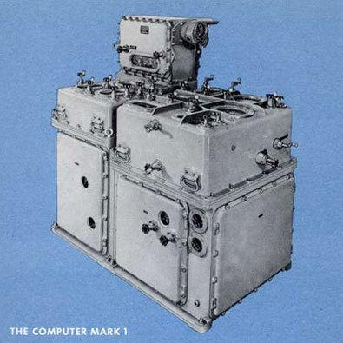
Analog Computer
The Ford Instrument Mark Fire Control Computer
US Navy ships from WW II to 1969.
Used to target, aim and fire large battleship guns
MARK 1 FIRE CONTROL
3 feet wide, 4 feet tall, 6 feet long and weighed nearly 3,000 pounds.
https://www.arnnet.com.au/slideshow/521520/pictures-10-cool-analog-computers/

Slide 9
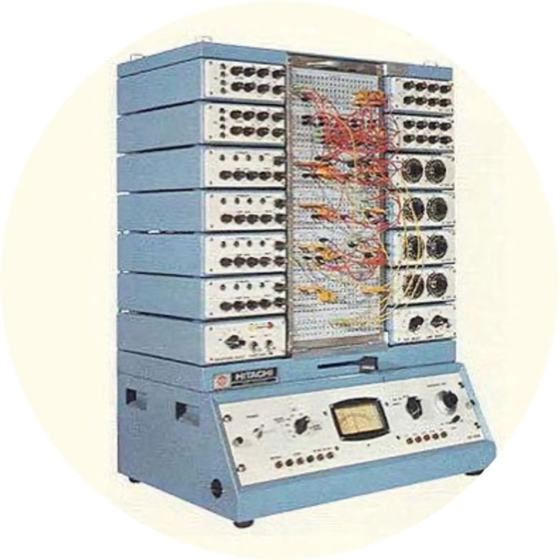
Analog Computer
HITAC (Hitachi Transistor Automatic Computer model 303E)
Used as large flight simulator for Japanese defense systems in the 1950s and 60s.
HITAC FLIGHT DEFENSE SIMULTOR

Slide 10
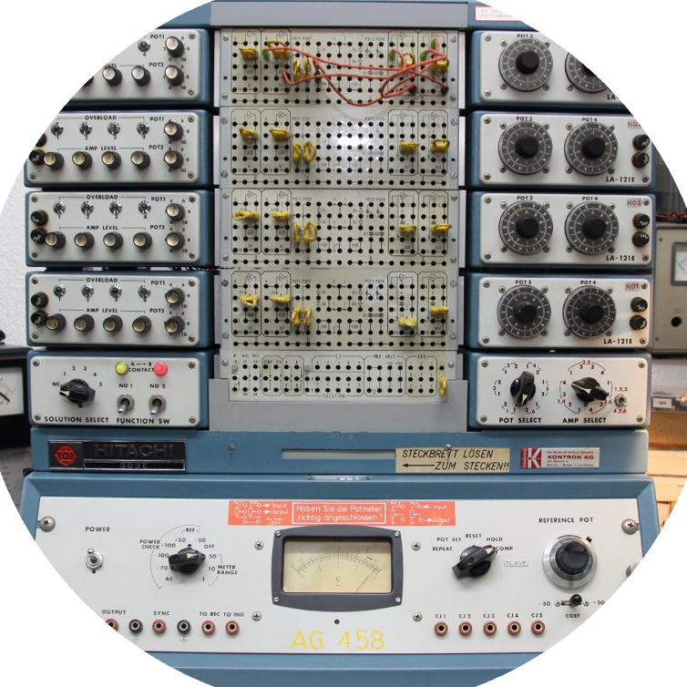
Analog Computer
HITAC (Hitachi Transistor Automatic Computer model 303E)
Used as large flight simulator for Japanese defense systems in the 1950s and 60s.
HITAC FLIGHT DEFENSE SIMULTOR

Slide 11
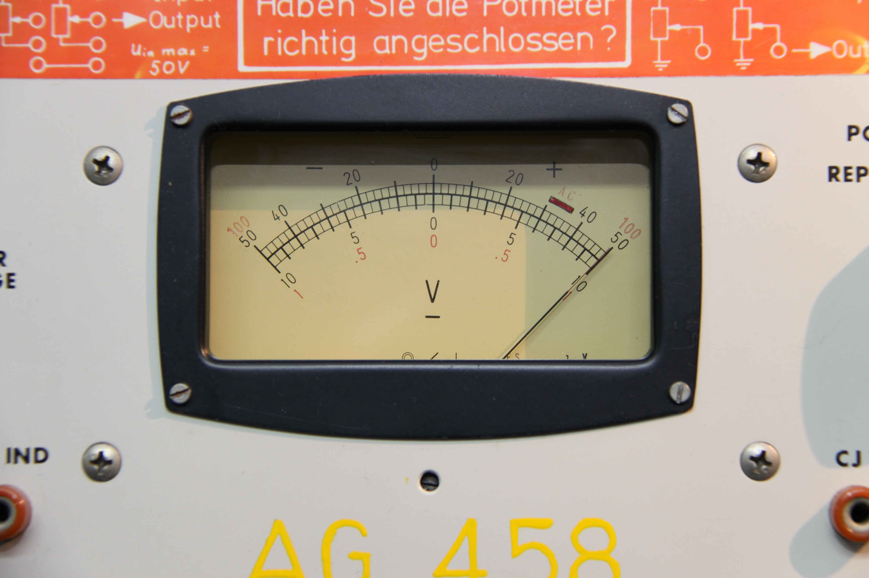
Analog Computer
HITAC FLIGHT DEFENSE SIMULTOR
HITAC (Hitachi Transistor Automatic Computer model 303E)
Used as large flight simulator for Japanese defense systems in the 1950s and 60s.

Slide 13
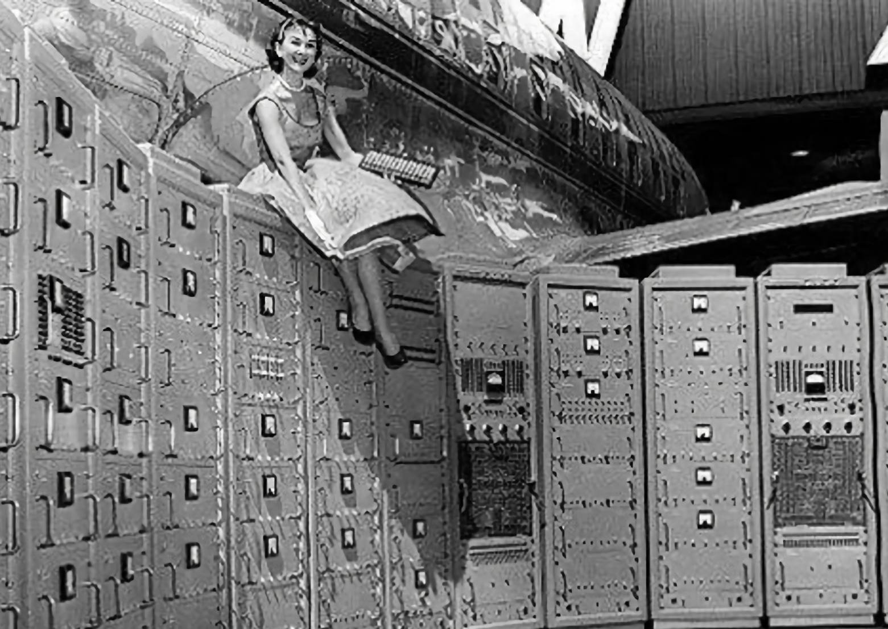
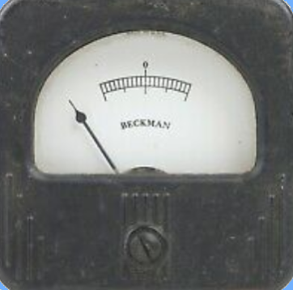
Analog Computer
Beckman Instruments EASE analog computer
60 feet long with push button control panel
Used by General Motors to design jet engines circa 1962

Slide 15
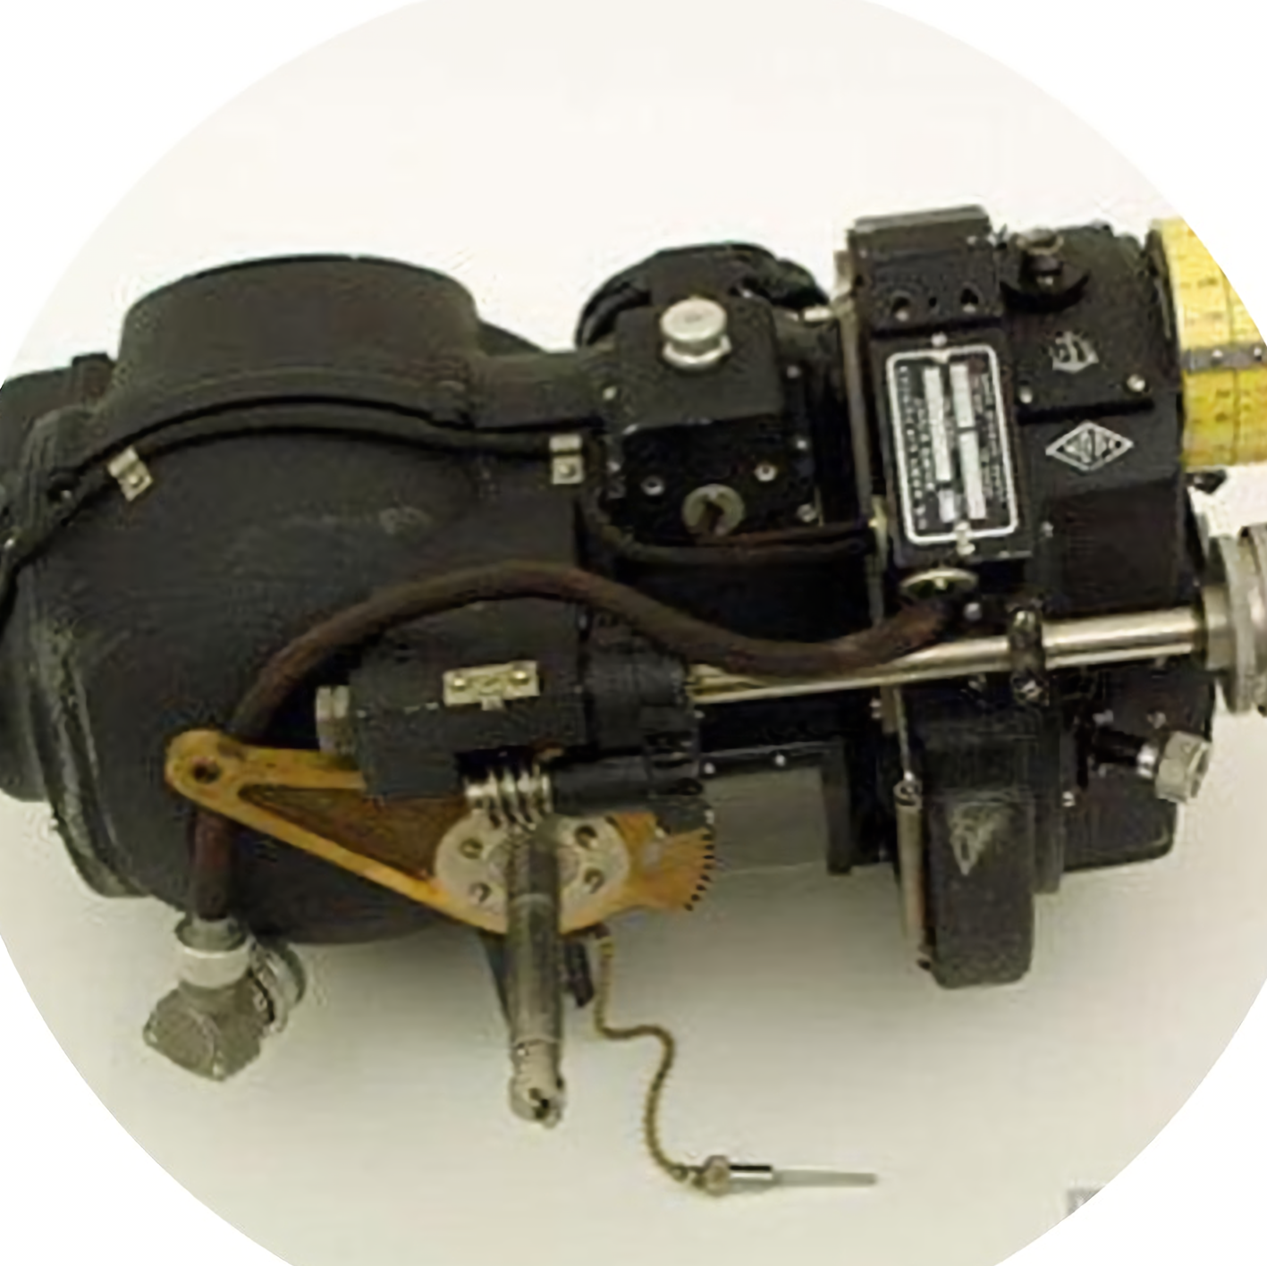
Analog Computer
Norden bombsight, a mechanical analog computer.
Gyroscopes, motors, gears, mirrors, levers and a telescope.
It could both pilot the aircraft and determine when to release payload.
Invention proved critical to successful high-altitude bombing during WW II.
https://www.arnnet.com.au/slideshow/521520/pictures-10-cool-analog-computers/

Slide 16
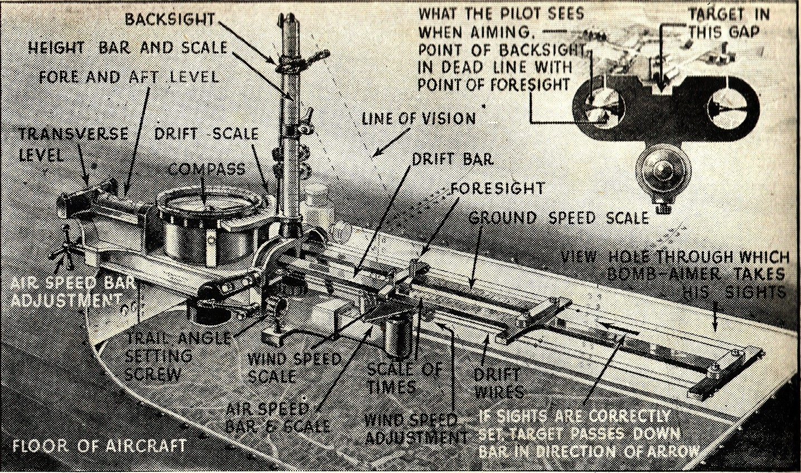

Slide 17
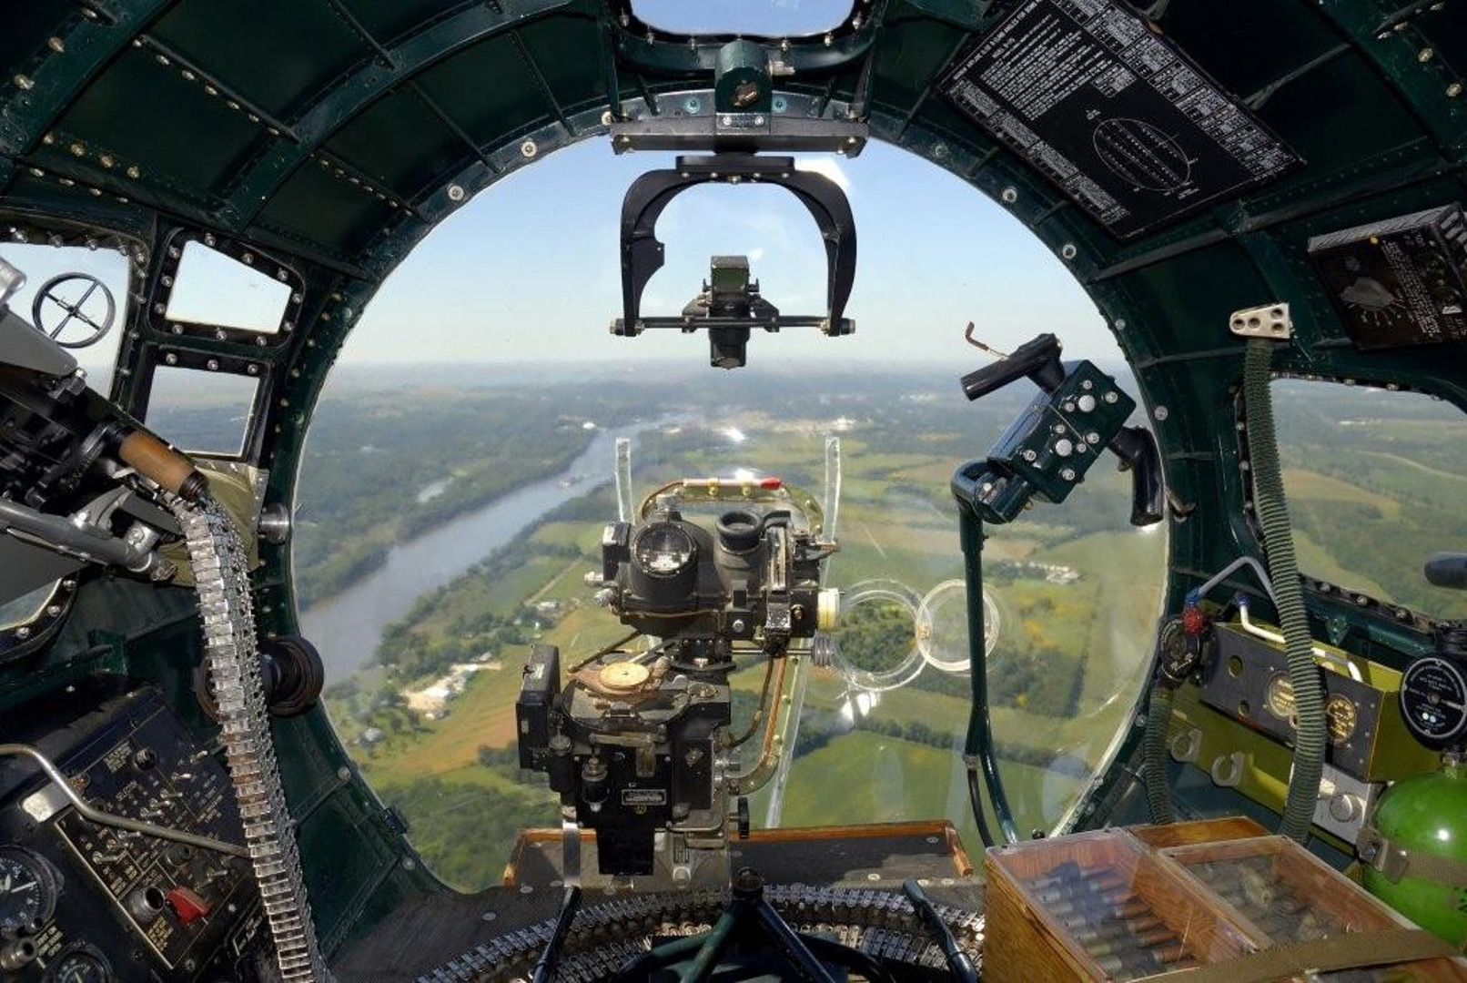

Slide 19
End of Part 2
Analog &
Digital
Devices

Slide 20
THANK YOU FOR WATCHING

